Slide 1
Government Human Resource Information System
(GHRIS)
Profile Update Procedure
(How To ….)
Prepared by:
Muthee Francis Lowa (APC)
Moderated by:
GHRIS Development Team
ghrishelp@msps.go.ke

Slide 3
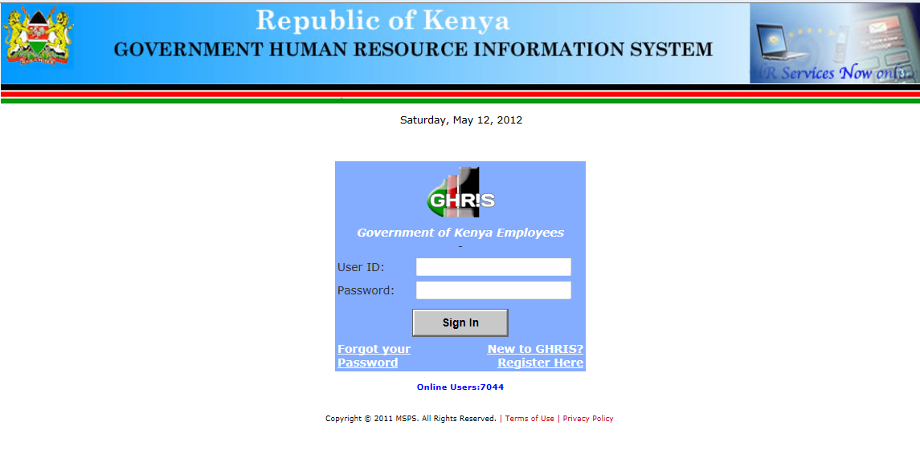
User ID:
Use your Full Civil Service Personal Number. E.g. 1984987654, 2002123456.
Password: Use what you supplied during registration or resetting
In case you forget your password, click here to reset it to a new one.
New users should click here to register and create their own password.

Slide 4
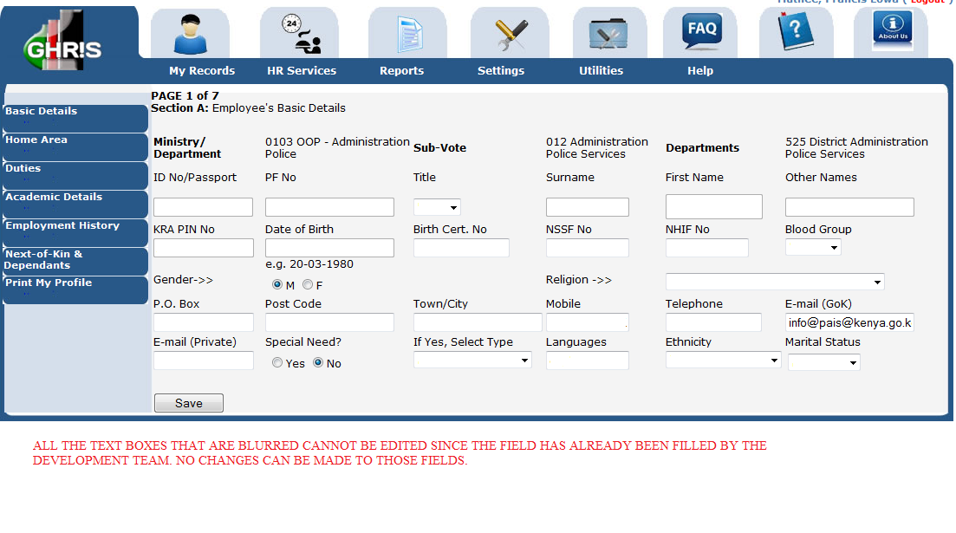
Fill all those dialog boxes that have not been filled by the HR system. Your Birth Certificate No. is of great importance in this page.
Any details you do not have please fill N/A.

Slide 5
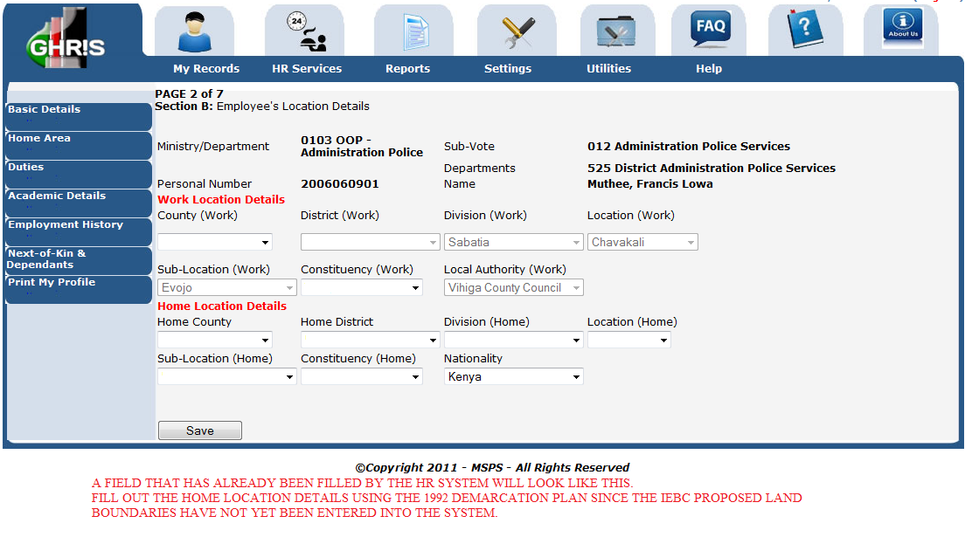
The blurred fields cannot be edited as above. In the Home location Details, you should use the 1992 demarcation since the IEBC presentation of the latest demarcation has not been integrated into the system.

Slide 6
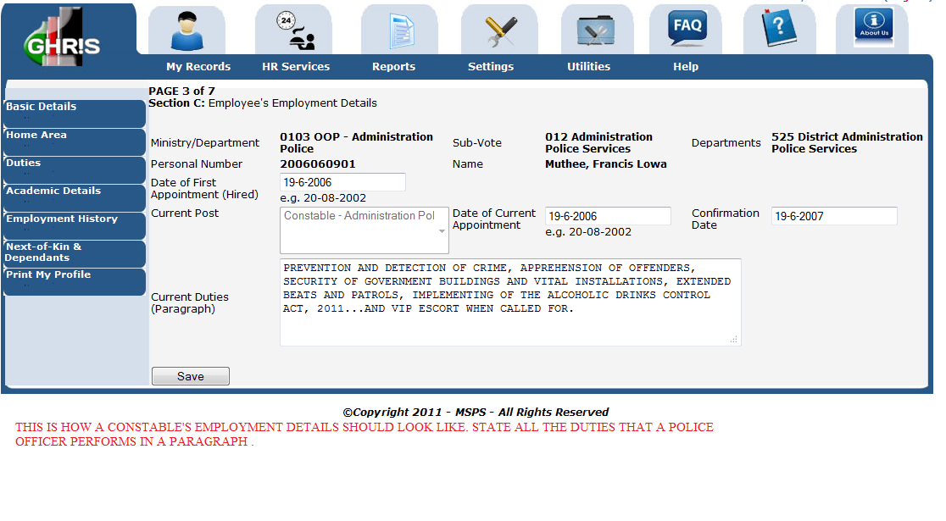
In the current duties, one should fill stating the current.
NB: THE DUTIES SHOULD BE STATED IN A PARAGRAPH.

Slide 7
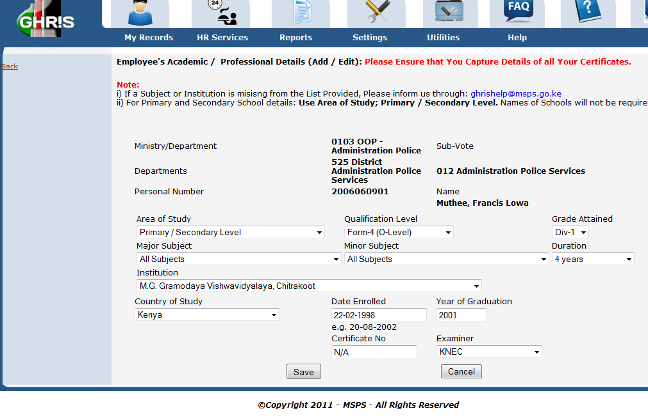
As for primary and secondary school education, since all schools are not listed, the important information that will be filled is the level of education, examining body, duration, country of study, date enrolled, year of graduation, and MOST IMPORTANTLY, certificate Number.
Give ALL the Certificates you have.

Slide 8
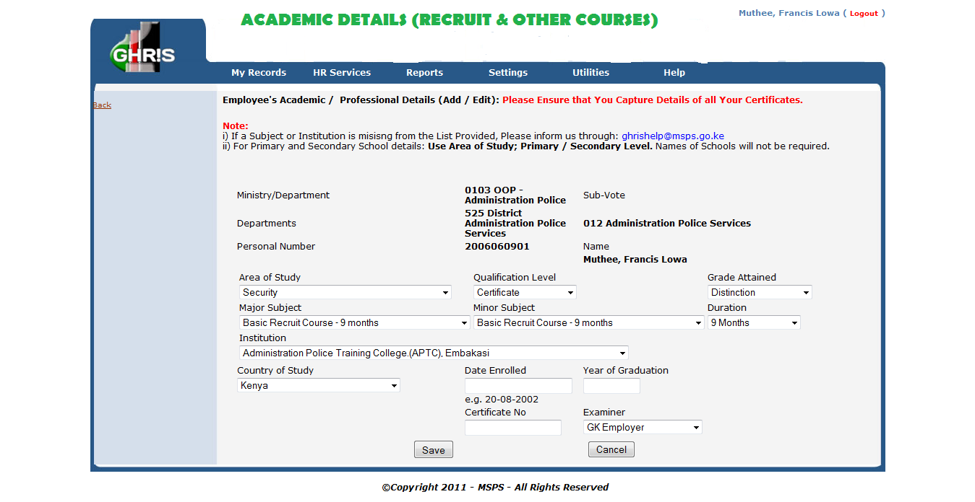

Slide 9
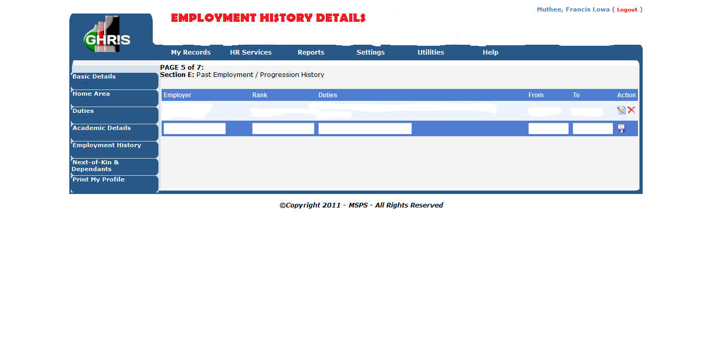
Specify the jobs you did previously before you joined the service or got employed in the civil service.
If none, proceed to enter details of your current employment.
If you have ever been promoted, you should know that that is a detail that should fall under a separate record.
The system auto-orders the details you input, you can key them in any order.

Slide 10
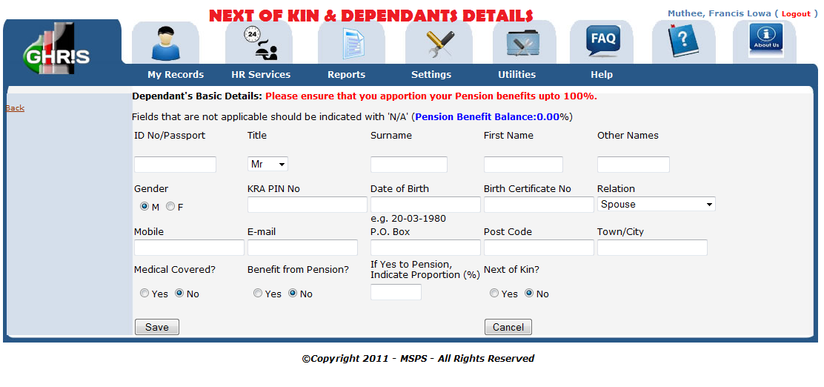
Pension Proportion (%) is OPTIONAL.
You can change the information any time .

Slide 11
SUMMARY
1. Fill in every empty box.
2. The information filled should be correct (Giving of false information will lead to prosecution and dismissal depending on the graveness of the offence e.g. forged document details)
3. The Birth Certificate No. is important.
4. For security purposes, the Certificate No. area in the professional details area should be filled (e.g. for an officer of the recruit course no. 2006 should fill out like, 1/2006).
5. In case you have studied at an institution that is not listed in the GHRIS system, use the email provided by the system to notify them to add it into the system.
6. If you have never been employed before, in the employment history section you will have to fill out details of your current employment. If you have ever been promoted, you should also include it. The system auto-orders the details you input, you can key them in any order.
7. In the next-of-kin section, DON’T worry about spouse’s/guardian’s or child’s Tax Pin and Birth Certificate No if you don’t have them. Just use the N/A entry detail.
8. If you’ve completely filled your profile, accessing the pay-slip should be easy. However, if you have not successfully completed the filling up of the profile, you will be prompted to UPDATE PROFILE FIRST.
9. ALWAYS USE THE PDF FORMAT TO VIEW YOUR PAYSLIPS ONLINE.
10. ALL THE BEST.
THE END

